Slide 1
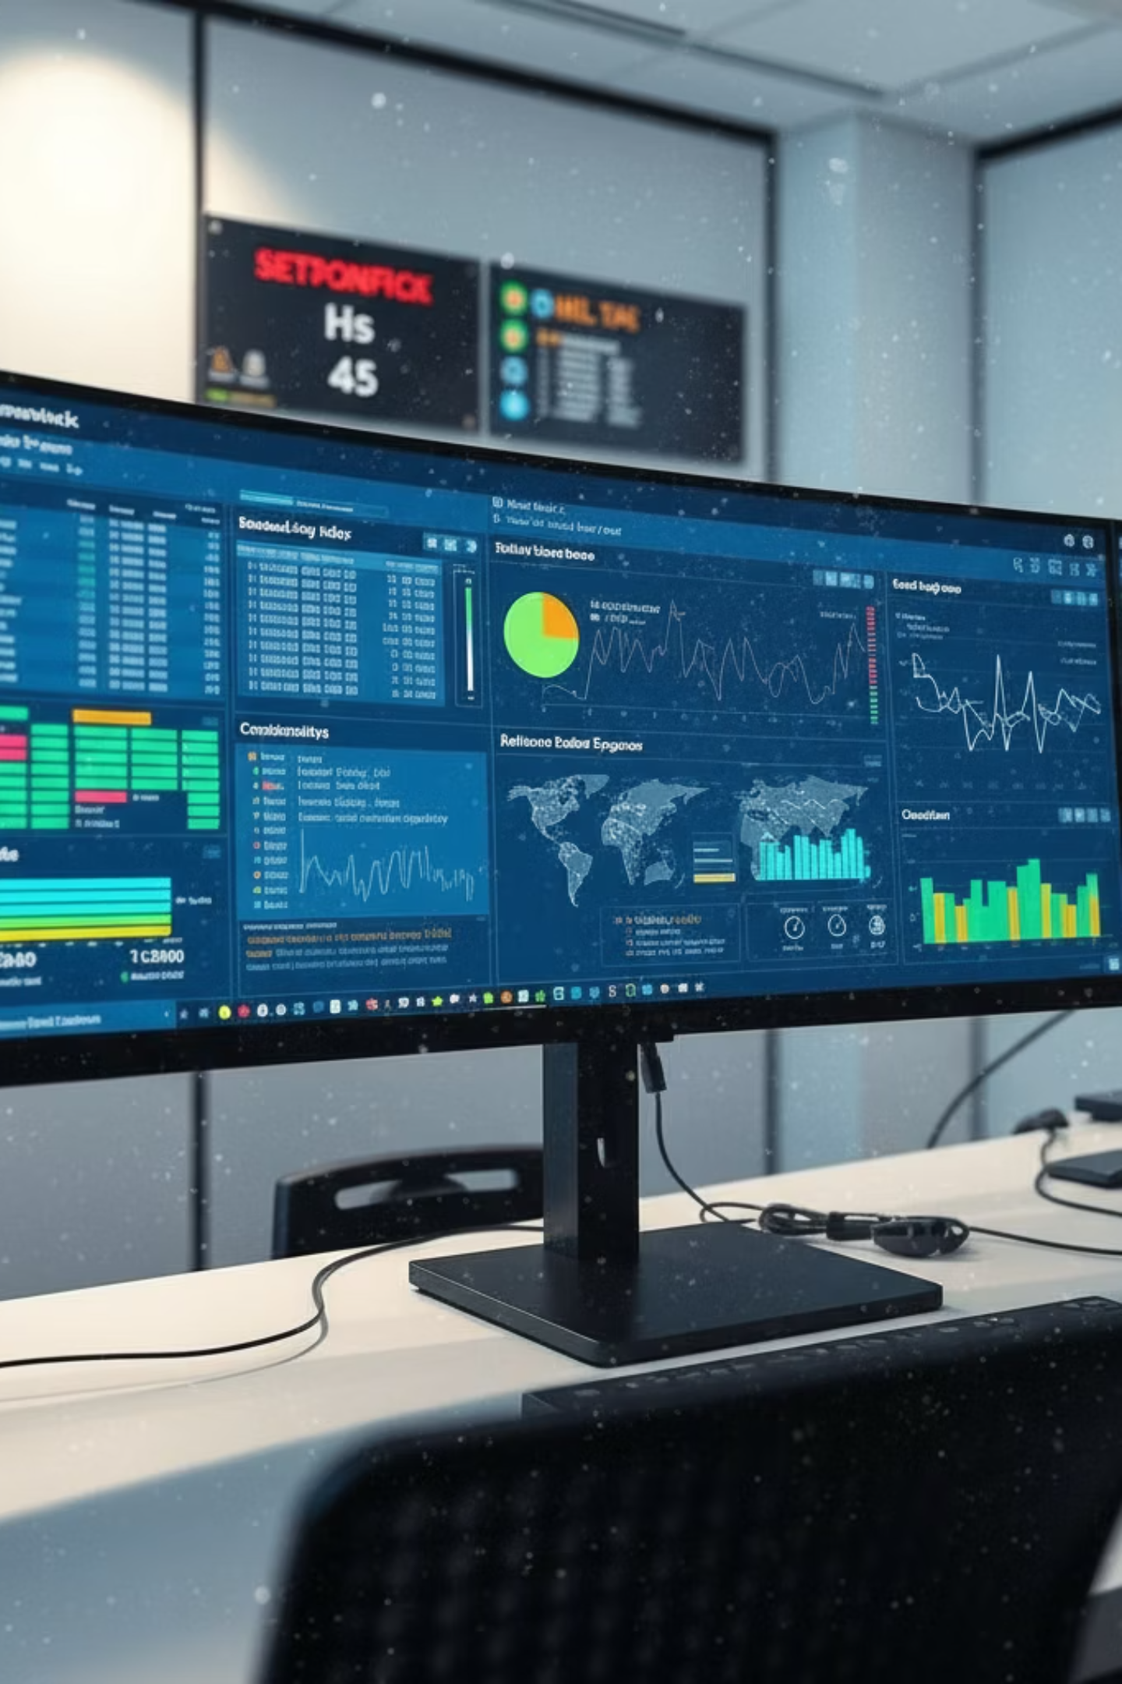
Defensive Security
Monitoring System
Presenter
Academic Supervision
Md Rayhan
Prof. Mohd. Zulfiquar Hafiz
IIT, University of Dhaka
IIT, University of Dhaka

Slide 2
Background & Motivation
Curiosity
How networking and security operate behind the surface level.
.
Learning Opportunity
Deep exploration of how packets are travel, how firewalls block packets, how defense mechanisms works etc.
.
Visualizations
Displaying real-time security metrics, alerts, and system statistics etc.
.
Notes:
This template was inserted from Power-user, the productivity add-in for PowerPoint, Excel and Word.
Install Power-user to access thousands of templates, icons, maps, diagrams and charts with Power-user.
Visit https://www.powerusersoftwares.com/
©Power-user SAS, terms of license: https://www.powerusersoftwares.com/terms

Slide 3

Objective & Architecture
The system operates as an integrated pipeline where each module is independently testable, maintainable.
Packet Capture
IDS Module
Blockchain
Firewall Engine
Logger
Real-time Dashboard

Slide 4

Core Technical Modules
🔍 Packet Capture Module
⚠️ IDS Detection Module
Uses libpcap library to sniff live traffic directly from network interfaces. Decodes Ethernet, IP, TCP/UDP headers and extracts payload data for analysis.
Monitors packet frequencies and patterns to identify suspicious behavior. Detects port scanning sequences, DoS flood patterns, and anomalous traffic signatures.
🛡️ Firewall Engine
🔐 Blockchain Logger
Maintains configurable rule sets for filtering decisions. Applies rules based on source/destination IPs, ports, and protocols with O(1) lookup performance.
Creates an immutable audit chain by linking events with SHA-256 hashes. Prevents retroactive log modification while maintaining full forensic records.

Slide 5
Expected Outcomes & Impact
Complete Network Visibility
Threat Detection
Real-time monitoring of all inbound and outbound network traffic with detailed packet analysis and flow tracking
Automated detection and alerting for port scans, DoS patterns, and intrusion attempts with immediate visibility
Verifiable Integrity
Deep Technical Mastery
Cryptographically immutable log chain ensuring all security records remain trusted and untampered throughout their lifecycle
Comprehensive hands-on understanding of network protocols, firewall mechanics, and security system architecture

Slide 6






Conclusion
This project merges networking, security, and blockchain integrity into a unified learning platform.By implementing these mechanisms from first principles in C++, we gain deep understanding of how defensive systems operate at the application level.
Security
Defense mechanisms and
threat detection
Networking
Protocol analysis and
packet processing
Integrity
Blockchain-secured
audit trails

Slide 7
Thank You

